Slide 1
Distributed Digital Preservation Workshop for ETDs
Gail McMillan, Virginia Tech
Martin Halbert, University of North Texas
Bill Donovan, Boston College
MetaArchive Cooperative
13th International Symposium on ETDs
University of Texas, Austin
June 16, 2010
Notes:
Welcome to the 3nd ETD Preservation Workshop. We’re here to share a preservation strategy for ETDs, one that we strongly believe in. We’re so glad to have you with us this morning, especially because we know that you may be nervous about ETDs because you probably don’t actually have a preservation strategy or plan for really long term access. Sit back and relax and listen, absorb, and react the information we’re going to share with you today about the NDLTD’s collaboration with the MetaArchive Cooperative will give you hope and confidence that real ETD preservation is not only doable, but it’s affordable.

Slide 2
Instructors
Martin Halbert
  Dean, University of North Texas Libraries
  President, MetaArchive Services Group
Bill Donovan
  Digital Imaging Librarian, Boston College
  Manager of Digitization Lab in the O'Neill Library
  ETD Administrator
Gail McMillan
  Director, Digital Library and Archives
  University Libraries, Virginia Tech
Notes:
Your instructors are: Gail Mc….. Martin Halbert, the new Dean of the University of North Texas Libraries since Oct. 1, 2009. Prior to that and throughout the first several years of our work in digital preservation, he was Director of Digital Programs and Systems at the Emory University Libraries since 1997. He’s been active in National Science Digital Library activities, Digital Library Federation and …The LoC calls Martin a noted digital preservation pioneer and I’ve been honored to work with him. He’s going to give you an overview of concepts and activities which comprise our distributed digital preservation network, including its infrastructure. He’ll also tell you about the various rolls that members of the MC play.
Bill Donovan, is the ETD administrator and Digital Imaging Librarian at Boston College, which is one of our newer MetaArchive Cooperative members. He’s been involved with BC’s migration from paper to scanned to born-digital ETDs and he’s going to share with you what its like to join forces with established members of the MetaArchive like VT and Emory.

Slide 3
Attendees
___ Universities
  ___ Libraries, ___ Graduate Schools. ___ Faculty
  Do your universities accept ETDs?
  If so, are they required?
___ National libraries
___ Vendors
___ Continents/Countries
Notes:
Now that you know who we are, let us see who you are:
universities around the world graduate school deans
national libraries:
vendor representatives:
Let’s begin by reviewing the agenda and then we’ll share with you information we feel is necessary to establish a sound preservation program and describe how the MC, can meet your institution’s needs so that you can consider joining with us to preserve ETDs and better ensure that they will be available for the long term.

Slide 4
Agenda
ETDs and preservation needs: Survey Results
Distributed digital preservation network overview
  NDLTD/MetaArchive Preservation Strategy
Collection Management for preservation readiness
  Organizing your ETD collections
  Metadata for Collections: Conspectus Database
MetaArchive Cooperative and its members
New member’s perspective: Boston College
A Preservation Plan
Notes:
We are informal and welcome your questions and comments. Please don’t hesitate to let us know if we start using jargon that you’re not familiar with.
The rest of the 1st 20 Min: GMc :a few definitions as a foundation and then report on the ETD Preservation Survey Results: It demonstrates the need for the NDLTD Preservation Strategy. In your packet: NDTLD Preservation Plan. Meant to provide enough detail about ETD Preservation Network.
09:00 – 09:45 MetaArchive and Distributed Preservation (Martin Halbert)
Overview of distributed digital preservation, LOCKSS, and the MetaArchive Cooperative (and TRAC). What is distributed digital preservation? How does it work? What does it require (hardware, software, tech support, staff and skills needed)?
09:45 – 10:15 NDLTD/MetaArchive ETD DDPN Archive (Martin Halbert)
Gain an understanding of the NDLTD/MetaArchive Dark Archive, including how we use it to implement ETD preservation, the roles and responsibilities of member institutions, and the basics of harvesting and ingest into the Dark Archive.
.
Break about 10:15—just 15 minutes. WHERE ARE THE BATHROOMS?
30 min: GMc: Highlights of good ETD collection organization for preservation readiness, metadata for ETD collections—MetaArchive Conspectus Database. Intellectual property.
30 min: MH: Review: Charter, membership agreement, and MC members’ responsibilities
30 min: BD: What’s it like to be a new member of the MetaArchive: Boston College’s perspective. And, share with us the initial stages of preparing a formal institutions preservation plan.

Slide 5
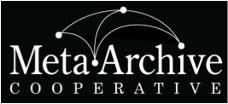
ETDs and Preservation Needs
Gail McMillan
Digital Library and Archives
Virginia Tech

Slide 6
What is Digital Preservation?
Systematic management of digital works over an indefinite period of time
  Processes and activities that ensure the continued access to works in digital formats
  Requires ongoing attention--constant input of resources: effort, time, money
  Technological and organizational change are obstacles for preserving beyond a few years.
Notes:
How can we preserve our ETD Collections and protect them from neglect--the “sands of time”, protect them from catastrophic events like fires and hurricanes, or hardware and software failures, or simple human error? We can implement pragmatic and affordable preservation strategies that exist today.
Consciously and systematically managing our digital works over an indefinite period of time is the definition of digital preservation that we’re using. We know that it requires
systematic management of computerized information over an indefinite period of time.
It demands continual attention
and this constant input of effort, time, and money to handle technological and organization change is the main stumbling block for preserving digital information beyond a few years.
I believe that the most effective preservation succeeds by replicating copies of digital content in secure, distributed locations over time because security reduces the likelihood that any single cache will be compromised and distribution reduces the likelihood that the loss of any single cache will lead to a loss of the preserved content. A single organization is unlikely to have the capability to operate several geographically dispersed and securely maintained servers. Inter-institutional agreements must be put in place or there will be no commitment to act in concert over time.
, Martin. MetaArchive presentation to SCHEV LAC, March 28, 2008.
And MetaArchive Cooperative offers such a preservation strategy and it is both affordable and easy to implement and maintain. But before going into the process and sample workflow, I want to clarify a few things

Slide 7
Backups ≠ Digital Preservation
Backups are tactical measures
  Make copies to restore originals after data loss event.
  Typically stored in a single location
    Often nearby
    Collocated with the servers backed up
Backups address short-term data loss with minimal investment resources
Notes:
Backing up is not the same as preservation. Backups are tactical measures--actions to reach a specific and near term end. We make regular copies (usually over-writing previous copies), and keep them handy to restore following a data-loss event. Did you know, however, that 30% of all archives have been backed up only one time or not at all” [according to the 2005 Northeast Document Conservation Center Survey by Bishoff and Clareson].
Preservation is a strategic goal to a long term outcome, and the means to achieve that goal. Backups are designed to address short-term data loss via minimal investment of money and staff resources. Backups are a good thing, but are not a comprehensive solution to the problem of preserving information over time.
Yes, many of our institutions are satisfied with backups, and VT was until we helped create a practical preservation option in 2003 through our work with the MetaArchive Cooperative.
An Institutional Repository is also not a preservation strategy. IRs are largely a centralized approach aimed at managing information flow within an institution.

Slide 8
Digital Preservation is Strategic
Long-term, error-free storage and for the entire time span the information is required.
Realistically address issues in preserving information over time
  Ongoing investment
  Geographically dispersed set of secure caches
  Multi-institutional collaboration
DDPN: Distributed Digital Preservation Network
Notes:
Digital Preservation is Strategic. Preserving information over long periods requires systematic attention, not benign neglect like we can get sometimes away with with books on our library shelves.
To realistically address the issues involved in preserving ETDs over time, a true digital preservation program requires
Geographically dispersed set of secure caches AND
Some ongoing investment
Therefore, a Distributed Digital Preservation Network (DDPN) is most effective like the MetaArchive Cooperative, which is a “community-owned, community-led initiative comprised of libraries, archives, and other cultural memory organizations. Using a technical framework that is based on the LOCKSS (Lots of Copies Keep Stuff Safe) software, members contribute digital collections into a geographically distributed network where they are mutually mirrored and refreshed on secure file servers in multiple locations.” [MetaA Content Policy]
The MetaArchive Cooperative is a distributed "dark archive" digital preservation option.

Slide 9
NDLTD Preservation Strategy: MetaArchive Cooperative
MetaArchive is a PLN: Private LOCKSS (i.e., distributed preservation) Network
Programmatically harvests ETDs from partners
  Secure access: only authorized partners’ servers
Preserves ETDs among partners’ servers
  Low cost to administer and run
  Standard hardware, open-source software
  Audits and repairs ETDs as needed
ETD Preservation Network is a Dark Archive.

Slide 10
ETD Preservation Survey
Gauge the digital library community’s interest in an ETD-specific archive
6 academic listservs
  ARL, ASERL, CGS, DLF
  NDLTD, ETD
14 multiple-choice and short answer questions
Dec. 13, 2007 - April 10, 2008
96 completed surveys

Slide 11
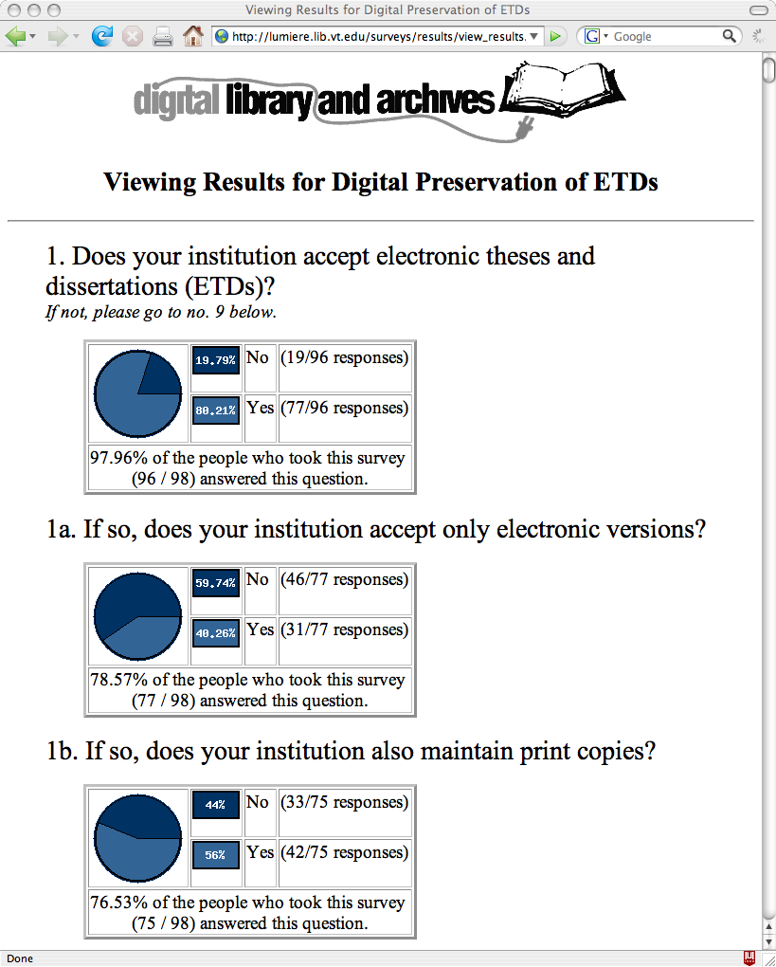
Notes:
Over three-fourths of the survey responses came from universities that accept ETDs. Over one-third of those respondents also reported that their institutions accept just the electronic formats while just over half of them also maintain print copies. It was expected that institutions with active ETD initiatives would be keeping up with relevant issues through the NDLTD or ETD listservs so it is not surprising that more of those universities accept ETDs. However, a smaller percentage of those institutions accept only electronic versions.

Slide 12
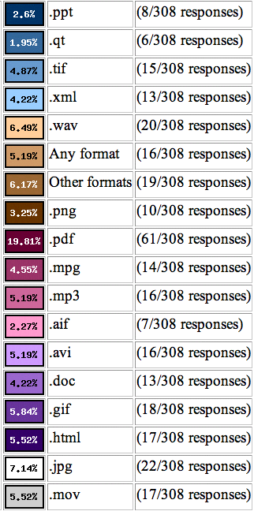
ETD File Formats
85% PDF
30% JPG
27% WAV
24% GIF
23% HTML, MOV
21% AVI, MP3
MetaArchive Conspectus Database
Notes:
The survey sought to determine the file formats that institutions accept with ETDs because this is an important element of preservation planning and of future format migration considerations. The MetaArchive is format agnostic, ingesting all file formats into its DDPN. The range of file formats that comprise ETDs at the survey respondents’ universities, matches those the MetaArchive has already ingested and those that were corrupted and rebuilt during extensive network testing.
Such information as file formats along with other metadata is tracked through the MetaArchive Conspectus Database, which contains each institution’s detailed descriptions of the collections in the DDPN. The metadata is used for a variety of purposes such as administration of the network (management, harvesting, maintenance, and recovery), public understanding of the collections, and future activities such as format migration.

Slide 13
Platforms and Institutional Repositories hosting ETDs
26% DSpace
13% ETD_db
3% Fedora
1% Eprints
29% Locally developed systems
29% Others
Notes:
As anticipated, ETDs are hosted by a variety of platforms and repositories.
Others mentioned were CONTENTdm, DigitalCommons, DigiTool, and ProQuest.

Slide 14
Structure of ETD Collections
25% Subject-like categories
21% Everything-in-one
21% Year
9% Accessibility
7% Degree
It’s best to group ETDs into discrete and finite units such as annual cumulations.
Notes:
There is a little less variety in the way collections of ETDs are structured.
Most frequently ETDs were organized by subject-like categories according to departments, colleges, or disciplines, according to 25% of the responses. Tied for the second most common collection organization, 21% each, were everything-in-one-collection and collections based on the year the degree was granted. The three other categories chosen were accessibility (9%), degree (7%), and author (5%). (12% of the responses did not address the question.)

Slide 15
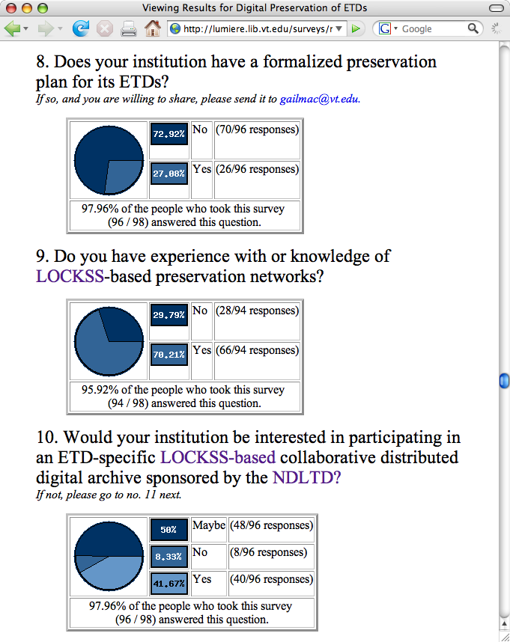
Notes:
Conclusion The survey responses indicated that ETD collections exist at 80% of their universities. However, a shocking 74% of those universities lack formal preservation plans for their ETD collections. This chasm demonstrates the dire need for a preservation strategy such as that offered by the MetaArchive Cooperative. Any preservation strategy will have to accommodate a broad range of file formats, repository systems, and ETDs in varied organizational structures.
An ETD-specific LOCKSS-based collaborative DDPN sponsored by the NDLTD is of interest to the majority of survey respondents. And a distributed digital preservation network may be a particularly good fit for an international organization such as the NDTLD as well as the fact that two-thirds of the responding universities already have experience with LOCKSS.
Not only did this survey demonstrate the need for and interest in a formal preservation strategy for ETDs, the majority of survey respondents also want to participate in the preservation activities, not just off-load their ETDs into a secure archive maintained by others. If this interest in preservation network participation becomes linked with the respondents’ interests in an open or dim archive, it will cause the MetaArchive to reexamine one of its founding principles—the separation of access from preservation in its distributed digital archive. But the NDTLD is now in a position offer guidelines for long-term preservation of ETDs.

Slide 16
NDLTD Preservation Strategy
NDLTD and MetaArchive Cooperative
  Help higher education institutions provide long-term open access to ETDs
  Institutions can achieve this goal by becoming part of the ETD Preservation Network.
Join: NDLTD www.ndltd.org
Join: MetaArchive Cooperative www.metaarchive.org

Slide 17
Notes:
In addition to the Workshop Agenda, you should have a copy of the NDLTD/MetaArchive Preservation Strategy. That, in addition to what you’re about to hear from Martin and Bill, will provide you lots of the information you need to put your ETDs on the secure path to being accessible in the long-term, including

Slide 18
NDLTD Preservation Strategy http://scholar.lib.vt.edu/theses/preservation/
Hardware
Software
Access
Intellectual Property
Organizing ETD Collections
Standards
Harvest Frequency
Institutional Workflow
Notes:
And much more information.
Now let me turn this workshop over to Martin Halbert who will provide you with a fuller overview
09:00 – 09:45 MetaArchive and Distributed Preservation (Martin Halbert)
Overview of distributed digital preservation, LOCKSS, and the MetaArchive Cooperative (and TRAC). What is distributed digital preservation? How does it work? What does it require (hardware, software, tech support, staff and skills needed)?
09:45 – 10:15 NDLTD/MetaArchive ETD DDPN Archive (Martin Halbert)
Gain an understanding of the NDLTD/MetaArchive Dark Archive, including how we use it to implement ETD preservation, the roles and responsibilities of member institutions, and the basics of harvesting and ingest into the Dark Archive.
.

Slide 19
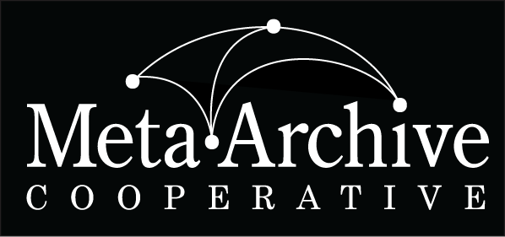
MetaArchive and Distributed Preservation
Dr. Martin Halbert
Dean of Libraries, University of North Texas
President, MetaArchive Cooperative
Distributed Digital Preservation for ETDs Workshop
University of Texas, Austin, TX
Wednesday, June 16, 2010

Slide 20
Session Questions
What is the MetaArchive Cooperative? Why did we form it?
What is distributed digital preservation? Why is it important for ETD preservation?
What is LOCKSS? How does MetaArchive use the LOCKSS software?

Slide 21
What led to MetaArchive?
Planning meetings by librarians and archivists in 2002-2003 on concerns about preserving digital archives
Sense that we needed to do something practical to help each other preserve our data
Not based on studies, just the observation of our anxieties about keeping our (expensive) digital materials preserved and viable.

Slide 22
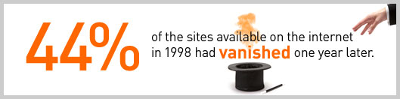
The Data Loss Problem
From NDIIPP Website on the Importance of Digital preservation
(http://www.digitalpreservation.gov/importance/):

Slide 23
The Gap in Digital Preservation Programs
66% of cultural heritage institutions (academic libraries, archives, art museums, public libraries, and other similar kinds of institutions) report that no one is responsible for digital preservation activities
30% of all archives have been backed up one time or not at all
Source: 2005 NEDCC Survey by Bishoff and Clareson

Slide 24
The Need for Collaborative Approaches
“The increased number and diversity of those concerned with digital preservation—coupled with the current general scarcity of resources for preservation infrastructure—suggests that new collaborative relationships that cross institutional and sector boundaries could provide important and promising ways to deal with the data preservation challenge. These collaborations could potentially help spread the burden of preservation, create economies of scale needed to support it, and mitigate the risks of data loss.”
- The Need for Formalized Trust in Digital Repository Collaborative Infrastructure
NSF/JISC Repositories Workshop (April 16, 2007)

Slide 25
Backups versus Digital Preservation
What differentiates a schedule for data backups from a digital preservation program?
Backups are tactical measures. Backups are typically stored in a single location (often nearby or collocated with the servers backed up) and are performed only periodically. Backups are designed to address short-term data loss via minimal investment of money and staff time resources. Backups are better than nothing, but not a comprehensive solution to the problem of preserving information over time.
Digital preservation is strategic. Preserving information over long periods requires systematic attention rather than benign neglect or unthinking actions.

Slide 26
Institutional Repositories versus Digital Preservation
What differentiates an IR program from a distributed digital preservation program?
The IR is not distributed. The IR is a centralized approach aimed at managing information flow within the institution. It typically does not attempt to securely cache prioritized content at multiple geographically dispersed sites.
DDP mobilizes efforts of multiple institutions. A digital preservation program entails a geographically dispersed set of secure caches of critical information. A true digital preservation program will require multi-institutional collaboration and at least some ongoing investment to realistically address the issues involved in preserving information over time.

Slide 27
Secure and Distributed Cache Networks
Why are the characteristics of geographically distribution and security so important? This strategy maximizes survivability of content in both individual and collective terms:
Security reduces the likelihood that any single cache will be compromised.
Distribution reduces the likelihood that the loss of any single cache will lead to a loss of the preserved content.
By creating a collaborative network for secure and distributed preservation, a group can also work together on more complex issues such as format migration.

Slide 28
Both Technical and Organizational Networking are Required
A single cultural heritage organization is unlikely to have the capability to operate several geographically dispersed and securely maintained servers
Collaboration between institutions on technological solutions is essential
Similarly, inter-institutional agreements must be put in place or there will be no commitment to act in concert over time

Slide 29
Shared Archiving Fails without a Pre-coordinated DDP Network in Place
Lessons from the NDIIPP Archive Ingest and Handling Test (AIHT) and other shared archiving experiments:
Encounter many unexpected incompatibilities because of different systems and data packaging
Realization that much of the cost in preserving digital material is in coordinating the organizational and institutional imperatives of preservation, and not the technological costs of storage space

Slide 30
MetaArchive
A distributed digital preservation cooperative for digital archives
Established under the auspices of and with funding from the National Digital Information and Infrastructure Preservation Program (NDIIPP) of the Library of Congress
A functioning DDP network and cooperative for libraries and other cultural memory organizations
Sustained by cooperative fee memberships, LC contracts, and other sponsored funding
Provides training and models for other groups to establish similar distributed digital preservation networks
Fosters broader awareness of digital preservation issues

Slide 31
MetaArchive Phase I (2004-2007)
Developed a working model for distributed digital preservation (DDP) in which institutions with shared subject domain focus mobilize for mutual benefit
Developed a technical solution for DDP based on a reuse of LOCKSS technology, in the form of a separate network with higher capacity nodes
Created an administrative nonprofit corporation
Began preserving via DDP hundreds of collections from many different organizations

Slide 32
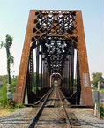

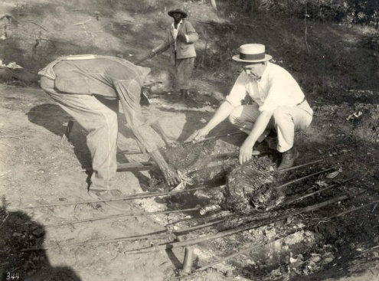
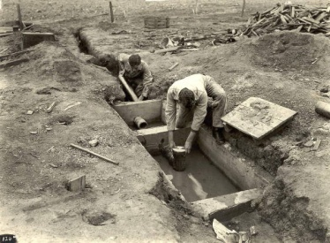
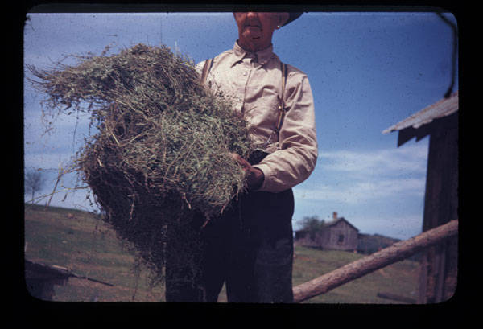
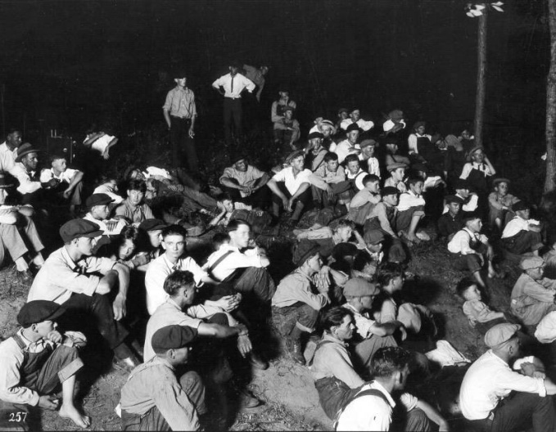
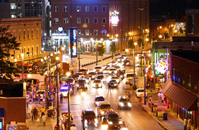
Collection Variety
Collections include:
  Images
  Text files
  Multimedia files
  Datasets
  Program executables

Slide 33
MetaArchive Founding Members

Slide 34
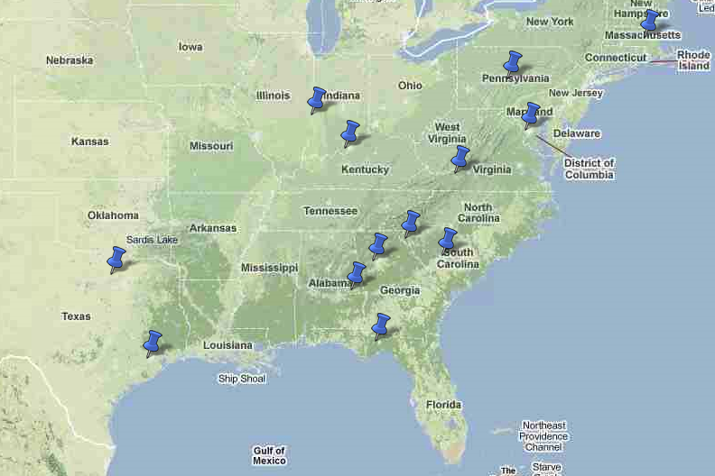
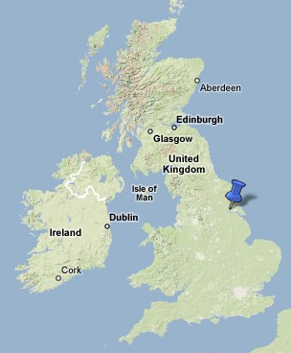
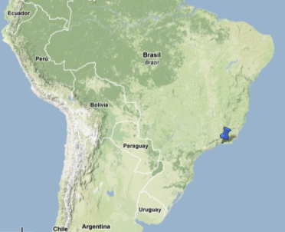
Membership Distribution
14 US Members
+ Lib. of Congress
2 Overseas Members

Slide 35
Current Members
Auburn University
Boston College
Clemson University
Emory University
Florida State University
Folger Shakespeare Library
Georgia Tech
Indiana State University
Library of Congress (Sponsor)
Penn State University
Pontifical Catholic University of Rio de Janeiro
Rice University
Hull University Wilberforce Institute
University of Louisville
University of North Texas
University of South Carolina
Virginia Tech

Slide 36
Catalytic Efforts
Began hosting workshops in distributed digital preservation strategies in 2007
  Instruct new MetaArchive members in processes
  Advise other groups considering DDP approaches
Assisted in creation of two additional DDPNs
  Alabama – state digitization projects
  Arizona – state government records

Slide 37
Technology: Building on Top of LOCKSS as a Solution for Preserving Digital Archives
Conspectus Database (First two versions)
  Curators enter collection level entries for collections
  Meant to be used for cooperative prioritization in DDP selection and decision-making activities
  Not interactive with some key MetaArchive systems (Cache Manager, Ingest Plugins)
Third Generation Conspectus Database
  Now in development
  Integrates operation of additional network functions
  Being designed in concert with guidance from other PLNs, hopefully in ways that enable re-use

Slide 38
Organizational Agreements and Models
Developed a new cooperative with guidance from both legal team, librarians, and intellectual property specialists
Created core organizational documents in 2006: charter, membership agreement, papers of incorporation, business plans, etc.
Allows members to understand their commitment and liability clearly

Slide 39
Collection Foci: Growing Archives in Subject & Genre Domains
Southern Digital Culture (initial collecting area, founding members were Southeastern)
Transatlantic Slave Trade Historical Data (made cooperative international)
Electronic Theses and Dissertations (inter-consortia strategic alliance with NDLTD)
Early Modern Literature (broad new area, with Folger Shakespeare Library as cornerstone)
Additional archives in planning stages

Slide 40
Active Collaborations with
Other Efforts
LOCKSS (collaborative development of LOCKSS Cache Manager)
Data-PASS Alliance (seeking to develop in-common standard for Private LOCKSS network interoperation standard and tools)
SDSC Chronopolis (PLN/ SRB interoperation testing and bridges)

Slide 41
MetaArchive Phase II (2007-2010)
Established additional distributed archives
Became international with the addition of Hull University in UK
Doubled in size 2008-2009, and plan to double in size each year for next three years
With funding from NHPRC now providing consulting and outreach services on the MetaArchive model for DDP services

Slide 42
MetaArchive TRAC Certification
The MetaArchive Cooperative underwent Trusted Repositories Audit & Certification (TRAC) certification process in late 2009, with MetaArchiveTRAC report issued in April 2010:
  http://www.metaarchive.org/sites/default/files/MetaArchive_TRAC_Checklist.pdf
Certification verified that MetaArchive passes all TRAC requirements, conforming to all 84 TRAC criteria

Slide 43
Institutional Roles
Preservation Sites are entities responsible for the ongoing activity of preserving digital content. At a minimum, every preservation site must include responsible staff and a node server of the relevant preservation network. Preservation sites collectively comprise a preservation network.
Development Sites are responsible for technical development of the computer systems that enable the preservation network. Obviously, development sites may also be preservation sites and/or contributing sites.

Slide 44
Factors to Consider
What level of participation are new MetaArchive members interested in? Running a node? Helping develop tools?
Metadata for items must be reposited as well, in a way that enables recovery in the case of need
Whose job is this going to be in the organization?
What are the highest priority items for distributed digital preservation?

Slide 45
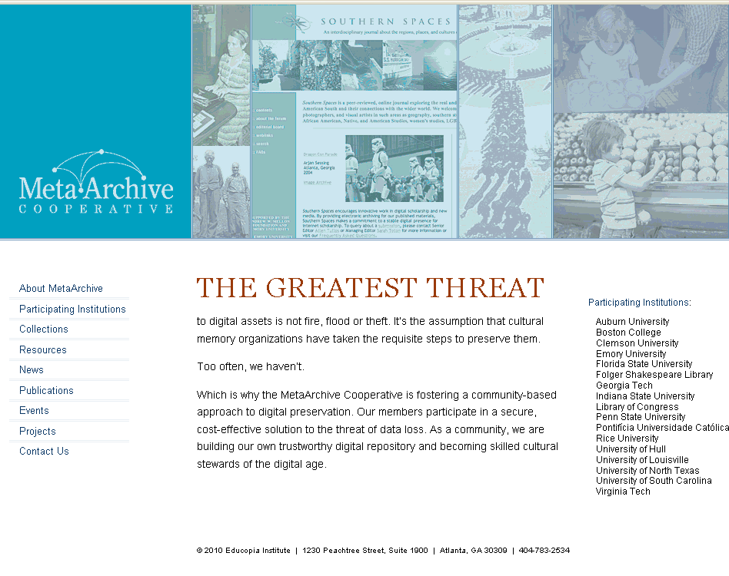

Slide 46
The NDLTD/MetaArchive
ETD Archive
Dr. Martin Halbert
Dean of Libraries, University of North Texas
President, MetaArchive Cooperative
Distributed Digital Preservation for ETDs Workshop
University of Texas, Austin, TX
Wednesday, June 16, 2010

Slide 47
Session Questions
Overview of the NDLTD/MetaArchive ETD Archive Partnership
Goals
Roles and responsibilities of new project collaborators
How to participate

Slide 48
NDLTD/MetaArchive ETD
Archive Program – 2009 Goals
Analyze and understand different scenarios for offering MetaArchive preservation services for NDLTD members
Test and document procedures and practices for NDLTD members to use MetaArchive network for preservation purposes
Negotiate joint discounts for NDLTD/MetaArchive membership fees
Solicit wider NDLTD involvement beginning with ETD 2009

Slide 49
NDLTD/MetaArchive ETD Archive
Program - Timeline
Jul 2009 - Selected additional program participants from existing MetaArchive members and new joint members
Nov 2009 - Concluded pilot project and transitioned to regular operations
Mar 2010 to present – Continued tools development and service modeling discussion

Slide 50
NDLTD/MetaArchive Participants
Current:
  VA Tech
  GA Tech
  Rice University
  Pontifical Catholic University of Rio de Janeiro
  Boston University
In Preparation Stage:
  Louisville
  FSU
  Clemson
  Auburn

Slide 51
Scenarios Explored for Preserving ETD Collections
Standard MetaArchive Model was adopted
  Builds on existing MetaArchive model for ETD preservation services
  Build up more joint members
Hub and Spoke Model is being explored
  Idea is to identify small number of NDLTD/MetaArchive service providers who will offer preservation functions for multiple NDLTD members

Slide 52
Seeking Additional NDLTD/MetaArchive Members
Looking for additional participants
Collaborators join both MetaArchive as well as NDLTD
Ideally, would like new members willing to participate in development of tools
If interested, contact Gail McMillan (gailmac@vt.edu) or Katherine Skinner (katherine.skinner@MetaArchive.org)

Slide 53
MetaArchive and its Members: Roles and Responsibilities
Dr. Martin Halbert
President, MetaArchive Cooperative
Distributed Digital Preservation for ETDs Workshop
University of Pittsburgh
Pittsburgh, PA
Wednesday, June 10, 2009

Slide 54
Session Questions
MetaArchive Charter and Membership Agreement
Two types of membership that that are available
Associated fees and responsibilities

Slide 55
MetaArchive Charter, Membership Agreement , and Host Nonprofit
Charter is a formative agreement that lays out the conceptual roles and responsibilities of participants
Membership agreement is between new members and MetaArchive’s administrative nonprofit corporation
  Agreement to preserve content for specified period
  Pledge to not intentionally harm the
  network

Slide 56
Two Membership Levels
Preservation Site Members: Operate a MetaArchive network node for specified period, using it to preserve content
Sustaining Site Members: Operate a node and participate in leadership of
cooperative

Slide 57
Associated Fees and Other Responsibilities
Two Membership Levels:
  Preservation Site Members ($1,000/year): Ability to reposit content in the shared network infrastructure
  Sustaining Site Members ($5000/year): Above, plus seat on the Steering Committee and participation in directing the cooperative
All members are obligated to provide and operate a minimal server on the network and accept at least as much content from others as they themselves reposit into the network
50 GB of network storage; adding content beyond specified base means adding incremental network storage fees of $2/GB per three year period
Membership commitment is in three year increments
Membership fees are reduced for members joining both NDLTD and MetaArchive simultaneously

Slide 58
Individual Roles
Program Managers are leaders that accept responsibility for coordinating the activities of a digital preservation network.
Data Wranglers are programmers and other technically adept workers that prepare local digital archives for ingestion into a preservation network.
System Administrators are staff members that maintain individual preservation node servers of the relevant preservation network.
Selectors are staff that identify and prioritize content to be preserved. They will most often be knowledgeable concerning the content of an institution’s digital archives, and may have been the same individuals that originally created or acquired the archives.

Slide 59
Archive Ingest Process
A “Plugin” is written for collections selected for preservation
Plugins are programs describing rules and structure for the “archival unit”
Either local staff or MetaArchive staff write these plugins and install them in the network
At least 6 dispersed sites are selected for repositing the archival unit
Caching process begins, with updates following if necessary

Slide 60
Requirements for Operating a Node
Be able to bring up and maintain a Linux server over time
Task local staff with both program management and systems administration duties, and preferably data wrangling as well
Contribute content and monitor system functioning occasionally
Sign membership agreement and pay membership dues

Slide 61
ETD Collections
Management for Preservation Readiness
Gail McMillan
Digital Library and Archives
Virginia Tech
Notes:
This is really about organization and much of it has to do with virtual organizing or what we’ve come to call Data Wrangling.
I’ll be covering information related to Appendices A and B in the NDLTD/MetaArchive Preservation Strategy.
This part of the workshop will provide details about good collection organization not only because it’s the practical thing to do, but because it will help you prepare a collection for harvesting and ingest into the preservation archive. We’ll also look at the creation of collection-level metadata using the MetaArchive’s conspectus tool and we’ll touch on intellectual property issues.

Slide 62
Best Practices:
Unique Directory Names
Standardized, uniform, easy to decipher
Timestamps
  etd-mmddyyyy-tttttt
  http://scholar.lib.vt.edu/theses/available/etd-10022007-144864
  ETD submitted on Oct. 2, 2007at 2:48:64 pm
Use same naming convention for scanned and born-digital ETDs

Slide 63
Best Practices: File Names
etd.pdf
  If file names are not unique, directory names must be unique
  May not be good for local management
Lastname_initials_doctype_year.format
  McMillanGM_T_1981.pdf
  SoundararajanS_D_2010.pdf
  SoundararajanS_D_2010_copyright.pdf

Slide 64
Best Practices: Archival Units
Discreet static (unchanging) units
  Annual ingest into preservation caches
>20 GB
  Divide annual directories into subunits
Notes:
Archival Units = LOCKSS jargon: AUs
SIPs: Submission Ingest Packages

Slide 65
Best Practices: Triage for ETDs
Inconsistent practices in directory structures, metadata, and file naming conventions
Rename, rearrange files or
Creative strategies needed
Adapt the existing situation to find, harvest, and ingest the files into the preservation network
Notes:
Identifying and correcting these problems will, of course, help not only with preservation, but also to improve local access.
rearrange files into a predictable order so that the ingestion path can be clearly defined

Slide 66
Best Practices: Triage for ETDs
How?
  Recognize there is a problem.
  Stop poor and practices.
  Isolate the problem files.
Data wrangling
  Define problem
  Adopt good (preservation) strategies.
    Create a direct path for ingest into preservation network
    Everything that doesn’t follow best-practices becomes one Archival Unit
Notes:
Identifying and correcting these problems will, of course, help not only with preservation, but also to improve local access.
rearrange files into a predictable order so that the ingestion path can be clearly defined

Slide 67
Best Practices: Metadata Discipline
Describe the institution’s individual ETDs
  ETD MS: ETD Metadata Standard
    http://www.ndltd.org/standards/metadata/etd-ms-v1.00-rev2.html
  MARC: MAchine Readable Cataloging
    http://www.worldcat.org/
Describe the institution’s ETD collection
  MetaArchive Conspectus Database
    http://www.metaarchive.org/conspectus

Slide 68
MetaArchive Conspectus Database
Overview of each collection being preserved in the ETD Dark Archive
  Descriptive information
  Network administration information
  Public awareness function
  Future considerations, e.g., format migration
Collection-level Metadata Specification
  Thoroughly defines the metadata elements
  http://metaarchive.org/sites/default/files/conspectus_md_2005.html
Notes:
See Appendix B, p. 14-16 of the NDLTD Preservation Strategy

Slide 69
MetaArchive Conspectus:
Descriptive Data
Details explaining the ETD collection to be preserved
  Title: formal name of the ETD collection
  Alternative Title: other names for the collection
  Description: explain or define the collection
  Subjects: describe the collection using terms from a thesaurus or controlled vocabulary

Slide 70
MetaArchive Conspectus: URI
Uniform Resource Identifier: usually a locator (URL) or name (URN)
  Collection’s URI
  Institution identifier: university assigned control number for the collection
  Is available via: public URL

Slide 71
MetaArchive Conspectus: Coverage
Describe the collection in space and time
  Spatial Coverage: geographical location--place or areas associated with the collection
  Temporal Coverage: time periods associated with the collection
  Accumulation Date Range: span of dates when the collection was assembled
  Contents Date Range: dates of creation of the digital collection

Slide 72
MetaArchive Conspectus:
Accrual Information
Details about the anticipated growth of the ETD collection
  Accrual Periodicity: frequency with which items will be added to the collection
    Daily, Weekly, Monthly, …No longer adding
  Accrual Policy: approach adopted to add items to the collection or anticipated growth

Slide 73
MetaArchive Conspectus:
Data Description
Formatting, size and language information
  Format Characteristics: physical or digital characteristics of the files in the collection
    audio: wav image: jpg text: pdf video: mpeg
  Language of the content of the collection
  Type: genre or category of the content of the collection
    Text, sound, datasets, software, animation, etc.
  Extent: size or duration of the entire collection

Slide 74
MetaArchive Conspectus:
Rights and Ownership
Description of the collection’s intellectual property
  Creator: originator of the ETD collection
  Publisher: entity responsible for making the ETDs available
  Rights: statement about who owns the copyright
  Access Rights: statement of restrictions placed on the collection, including allowed users, charges, etc.
    Restricted Unrestricted
  Custodial History: changes in ownership, custody of the collection, integrity and interpretation; provenance
  Manifestation: reformatting quality attribute
    Access Preservation Replacement

Slide 75
MetaArchive Conspectus:
Related Resources
Use of and references for the collection
  Associated publications
  Subcollections
  Supercollections
  Catalog or description
  Cataloged status
  Associated collections
Notes:
Expanded descriptions on p 16 of NDLTD Preservation Strategy

Slide 76
MetaArchive Conspectus:
Harvesting Information
Details about the web crawl that will gather the files into the ETD Dark Archive
  Harvest Procedure: Web crawl or OAI harvest
  Plugin Identifier: URI or URL
  Extra Parameters: Archival Units, e.g., year = 2007
  LOCKSS Manifest Page: permission to preserve
  OAI provider
  Risk Rank: designates the degree to which the collection is in jeopardy (5 choices from extreme to low risk)
  Risk Factors: describe the reason this collection is endangered.

Slide 77
MetaArchive
A New Member’s Perspective
Bill Donovan
Digital Imaging Librarian, ETD Administrator
Boston College

Slide 78
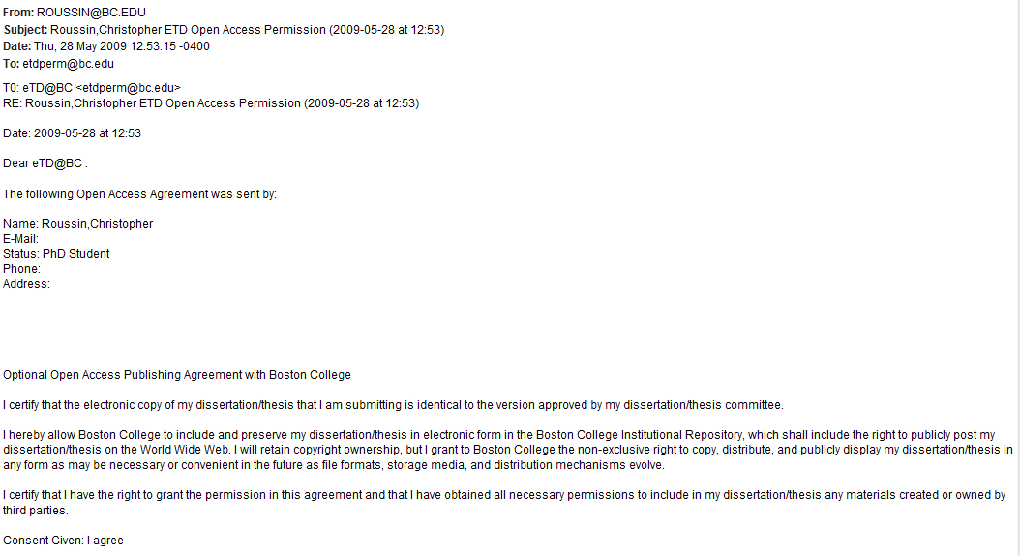
Open Access permission

Slide 79
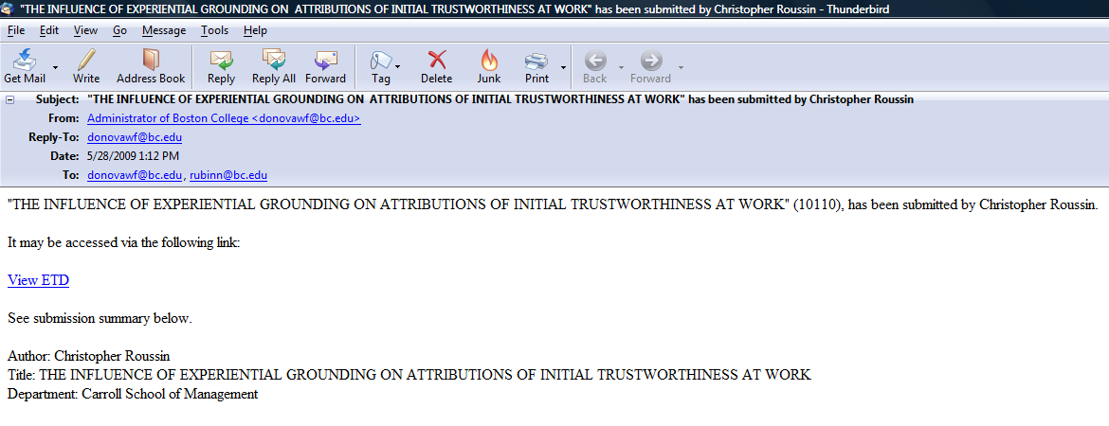
ETD submission notification

Slide 80
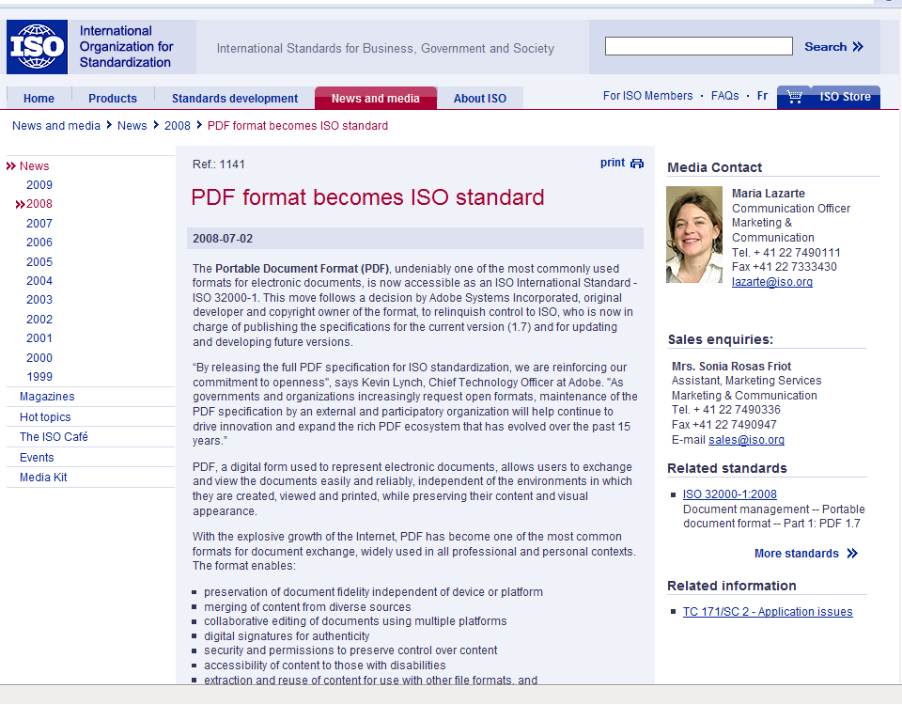
Preservation file formats

Slide 81
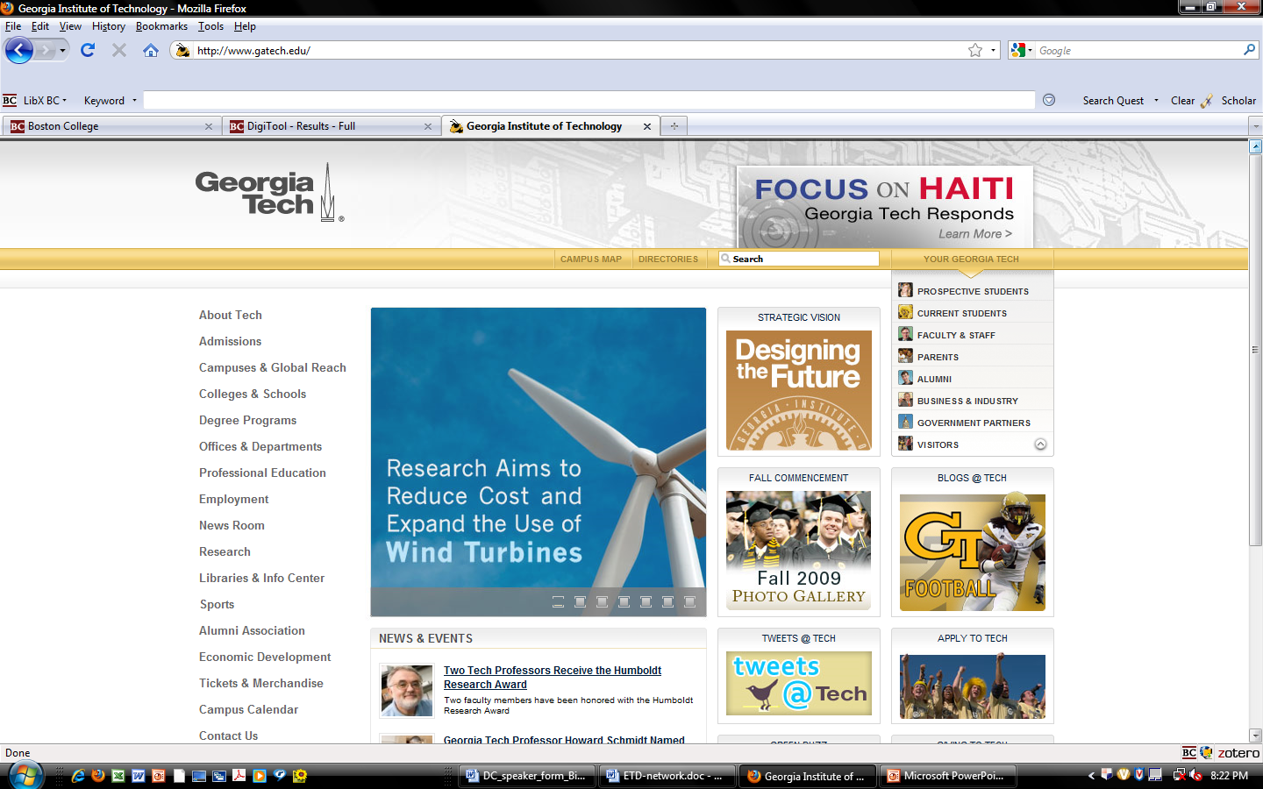
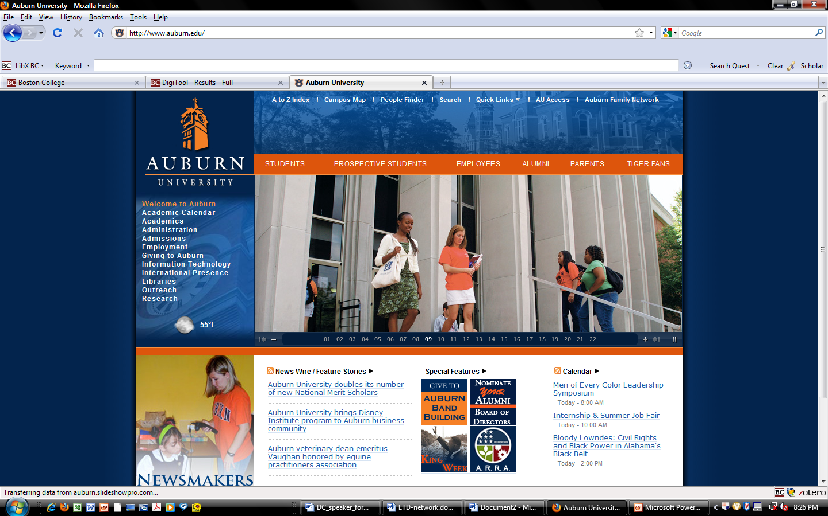

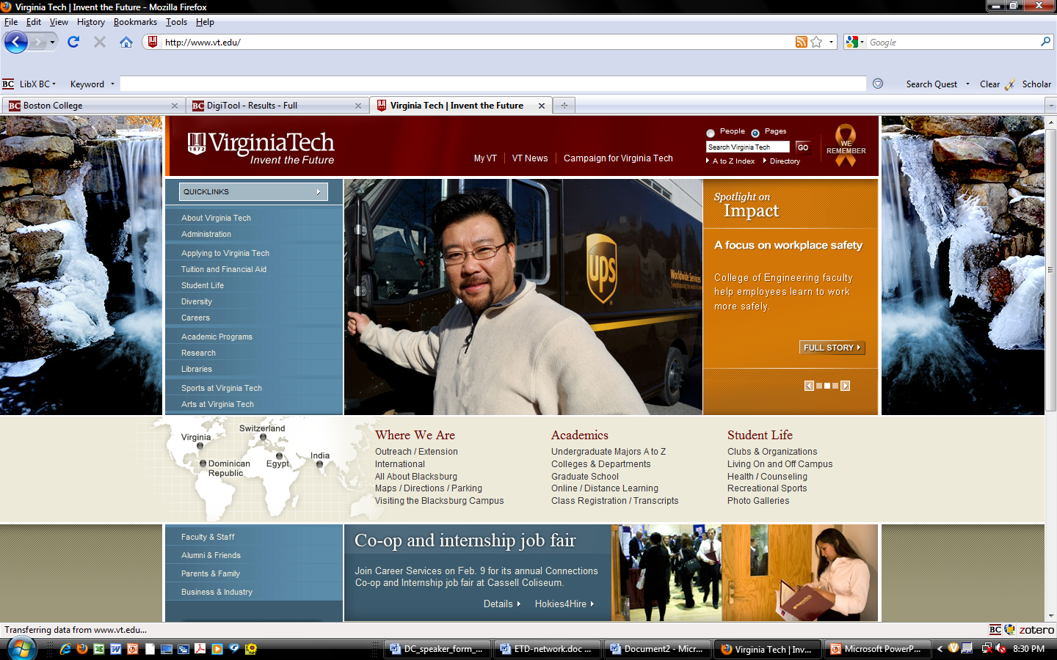
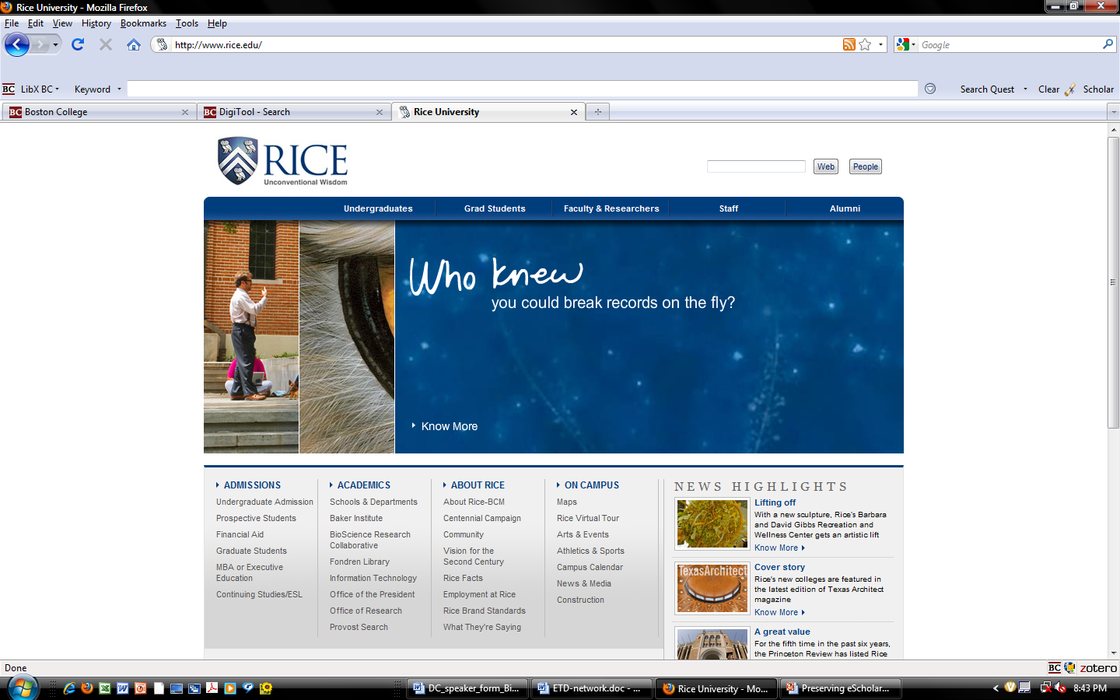
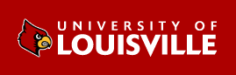
MetaArchive’s ETD network

Slide 82
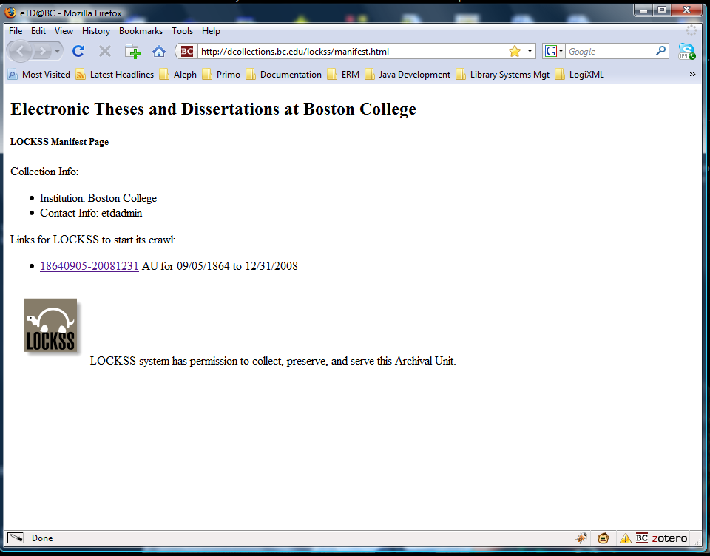

Slide 83
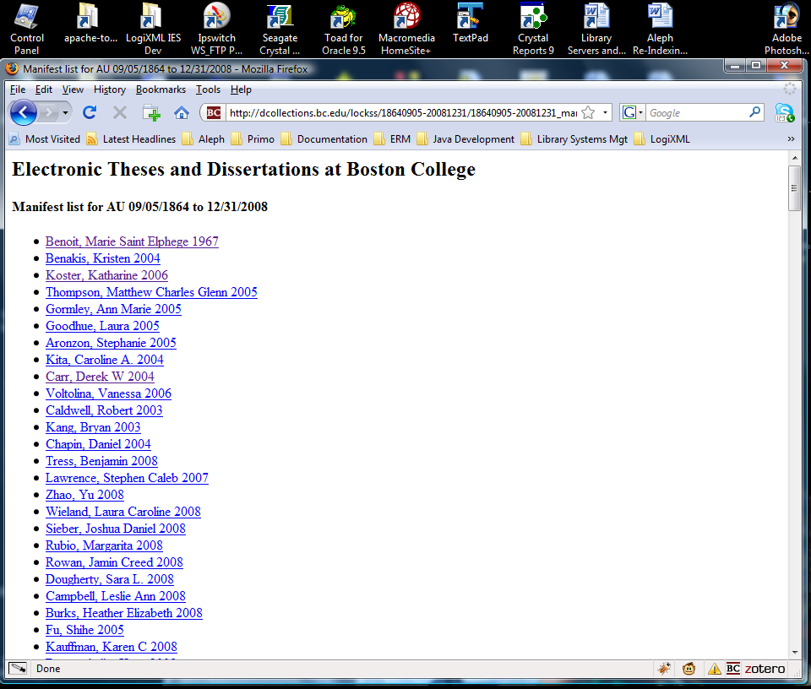

Slide 84
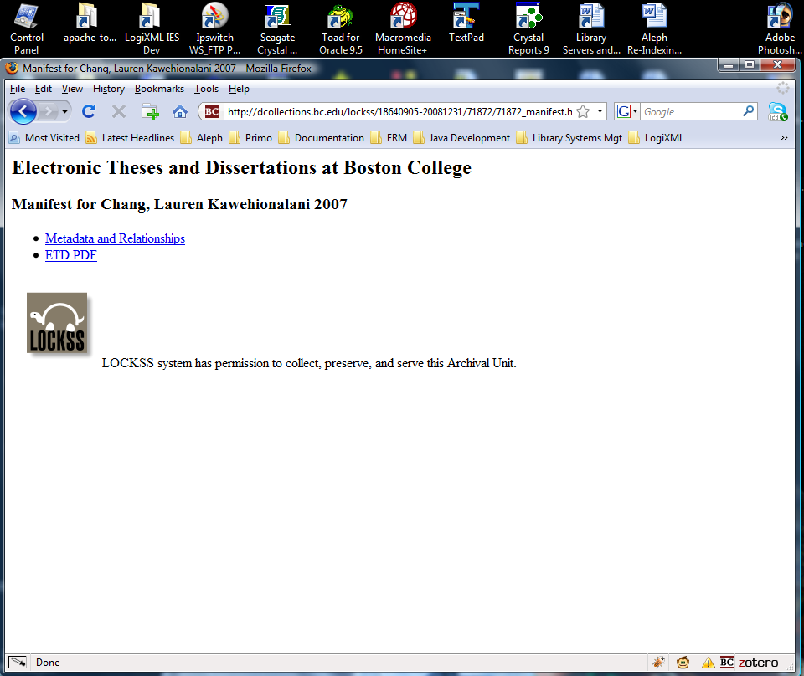
http://dcollections.bc.edu/webclient/DeliveryManager?metadata_request=true&GET_XML=1&pid=71872
http://dcollections.bc.edu/webclient/DeliveryManager?pid=71872

Slide 85
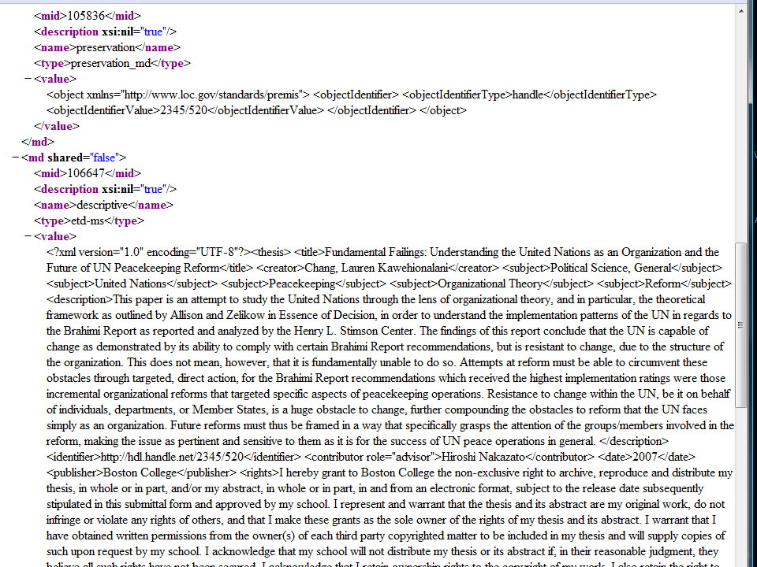

Slide 86
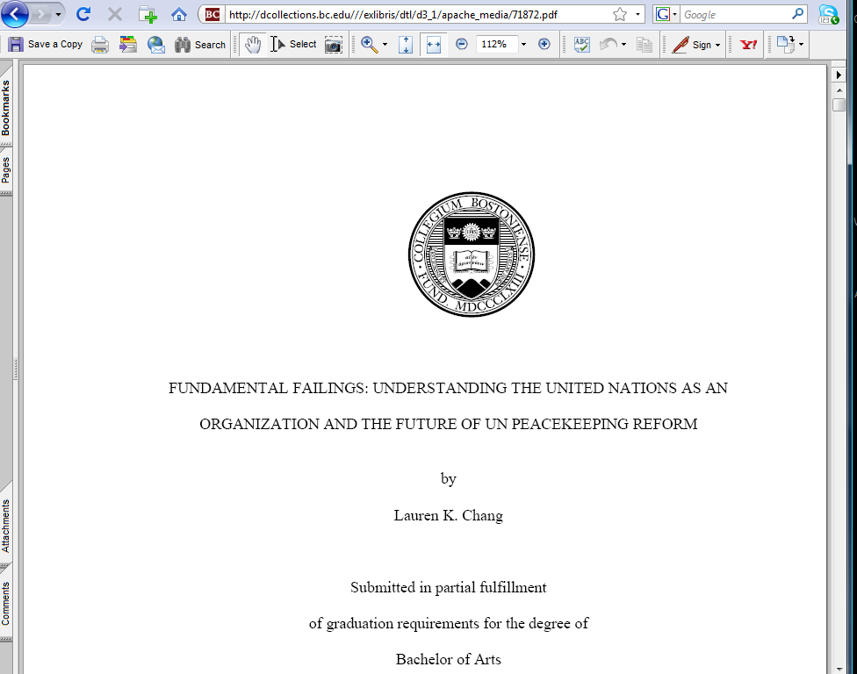

Slide 87
Preserving Scholarship at Boston College
Bill Donovan
donovawf@bc.edu

Slide 88
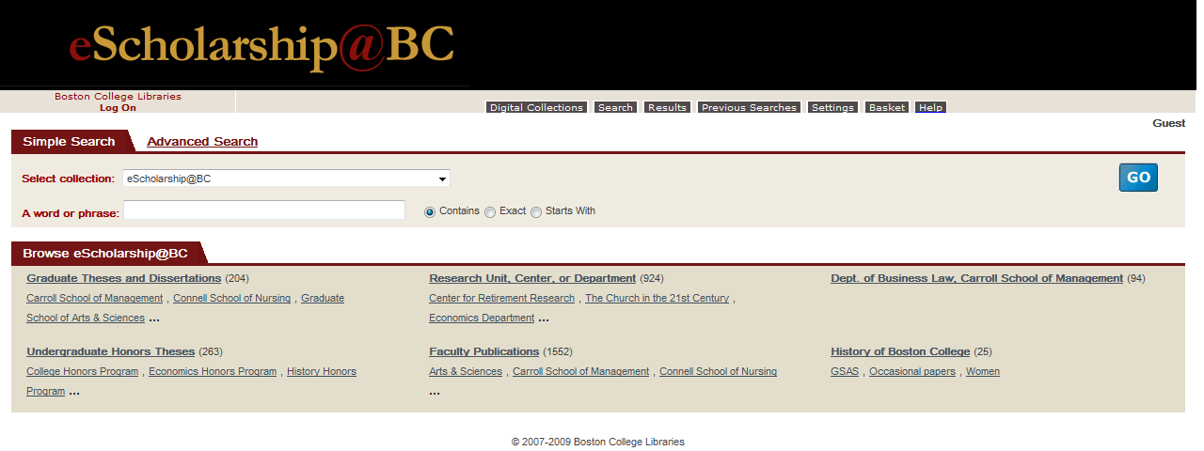
eScholarship@BC
(institutional repository)

Slide 89
MetaArchive’s ETD network

Slide 90
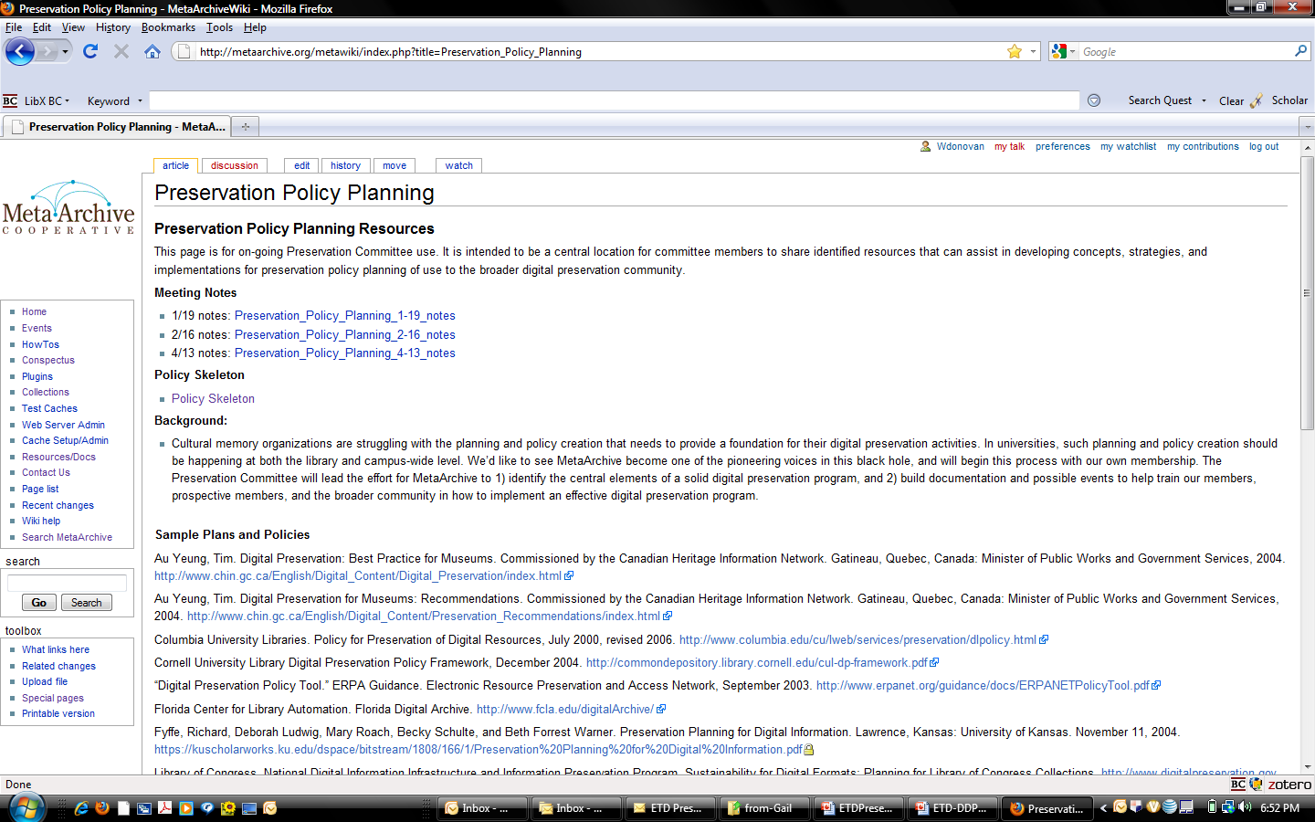
MetaArchive Preservation Cmte

Slide 91
“Digital Preservation” defined
“Digital preservation combines policies, strategies and actions that ensure access to digital content over time.”
http://www.ala.org/ala/mgrps/divs/alcts/resources/preserv/defdigpres0408.cfm

Slide 92
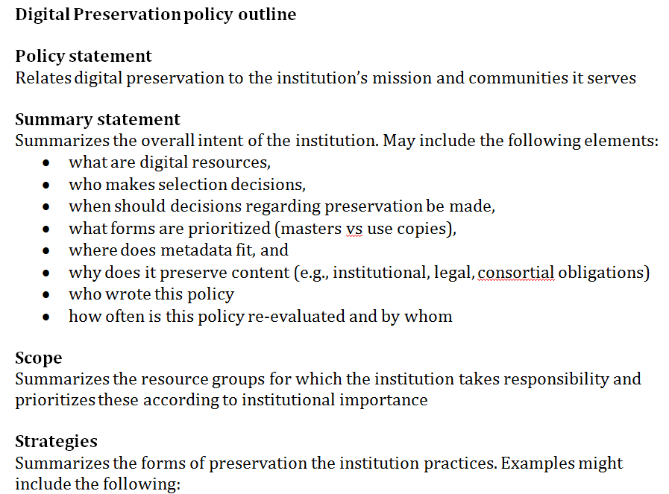
DDP policy skeleton

Slide 93
For more details…
http://metaarchive.org/GDDP

Slide 94
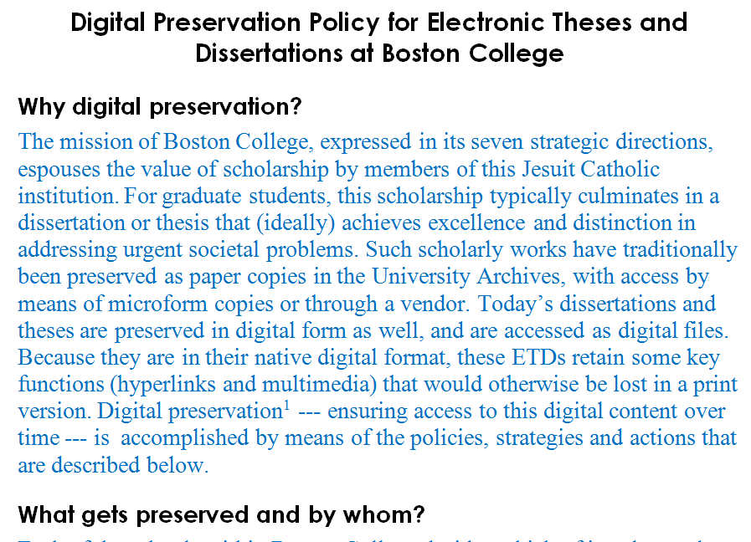
DDP policy for Boston College

