Slide 1
Preserving ETDs: NDLTD & MetaArchive Collaboration
Gail McMillan
Digital Library and Archives, Virginia Tech
Newcomers’ Workshop @ USETDA 2012

Slide 2
What is Digital Preservation?
Systematic management of digital works over an indefinite period of time
Processes and activities that ensure the continued access to works in digital formats
Requires ongoing attention--constant input of resources: effort, time, money
Notes:
Preservation means Consciously and systematically managing our digital works over an indefinite period of time.
How can we preserve our ETD Collections and protect them from neglect--the “sands of time”, catastrophic events like fires and hurricanes, hardware and software failures, or simple human error?
Another Challenge to preservation is organizational changes. Therefore, we need ongoing commitments at a high level within each of our organizations.

Slide 3
Backups ≠ Digital Preservation
Backups are tactical measures
Make copies to restore originals after data loss event.
Typically stored in a single location
Often nearby
Collocated with the servers backed up
Backups address short-term data loss with minimal investment resources
Notes:
We also need to understand what Preservation Is Not: Backups are not the same as preservation. Backups are tactical measures--actions to reach a specific and near term end. Most of us make regular copies and keep them handy to restore following a data-loss event. But you may not be aware that these copies usually over-write previous copies. I hope your institution isn’t one of the 30% of all archives that have been backed up only one time or not at all according to the 2005 Northeast Document Conservation Center Survey by Bishoff and Clareson.
Preservation is a strategic goal to a long term outcome, and the means to achieve that goal. Backups are designed to address short-term data loss via minimal investment of money and staff resources. Backups are a good thing, but are not a comprehensive solution to the problem of preserving information over time.
Yes, many of our institutions are satisfied with backups, and VT was until we helped create a practical preservation option in 2003 through our work with the MetaArchive Cooperative.
An IR is also not a preservation strategy. They are largely a centralized approach aimed at managing information flow within an institution.

Slide 4
Digital Preservation is Strategic
Long-term, error-free storage and for the entire span of time the information is required.
Realistically addresses issues in preserving information over time
Ongoing investment
Geographically dispersed set of secure caches
Multi-institutional collaboration
DDPN: Distributed Digital Preservation Network
Notes:
Digital Preservation is Strategic. Preserving information over long periods requires systematic attention, not benign neglect like we can get sometimes away with like books on our library shelves.
To realistically address the issues involved in preserving ETDs over time, a true digital preservation program requires
Geographically dispersed set of secure caches AND
Some ongoing investment
Therefore, a Distributed Digital Preservation Network (DDPN) is most effective like the
MetaArchive Cooperative, which is a “community-owned, community-led initiative comprised of libraries, archives, and other cultural memory organizations. Using a technical framework that is based on the LOCKSS (Lots of Copies Keep Stuff Safe) software, members contribute digital collections into a geographically distributed network where they are mutually mirrored and refreshed on secure file servers in multiple locations.” [MetaA Content Policy]
The MetaArchive Cooperative is a distributed "dark archive" digital preservation option.

Slide 5
ETD Preservation Network is
Dark Archive
For preservation, not access
Secure
PLN: Private LOCKSS Network
Distributed Geographically Caches
The loss of any single cache will not lead to loss of the preserved information.
A single organization is unlikely to have the capability to operate several geographically dispersed and securely maintained servers.
Inter-institutional agreements will ensure commitment to act in concert over time.
Notes:
A Distributed Digital Preservation Network mobilizes efforts of multiple institutions. It entails a geographically dispersed set of secure caches which isn’t something a single institution is likely to have. A true digital preservation program will require multi-institutional collaboration and at least some ongoing investment to realistically address the issues involved in preserving information over time.
LOCKSS open source software from Stanford University is used differently (than it was originally intended, i.e., for ejournals) because user access and preservation are completely separate in the secure and private ETD preservation network.
A PLN is a peer-to-peer system of geographically distributed servers running LOCKSS, as its main application. With this application computer programs are running in the background without human intervention, that among other things poll each other about content, vote on the content to determine its integrity, and when necessary restoring damaged content.
This approach offers Security to reduce the likelihood that any single cache will be compromised, AND Distribution reduces the likelihood that the loss of any single cache will lead to a loss of the preserved content.
But even Shared Archiving will fail without a precoordinated DDP Network in Place. It is well known that much of the cost in preserving digital material is in coordinating the organizational and institutional imperatives for preservation, and not the technological costs. [Library of Congress [NDIIPP] Archive Ingest and Handling Test (AIHT)]
But even if this is a good idea, how can our institutions possibly implement such a strategy?

Slide 6
Why participate in the MetaArchive?
While collection building has largely been a local act, preserving them required us to consider a new approach, one that is more explicitly built on establishing networks of trust and shared responsibility. MetaArchive has provided Penn State with more than preservation methods. It also gives us the chance to learn from experts in the field located across the entire network. Mike Furlough, Penn St.
Notes:
Mike Furlough, Assistant Dean for Scholarly Communications and Co-Director, Office of Digital Scholarly Publishing, Penn State University Libraries
http://www.metaarchive.org/references

Slide 7
ETD Preservation Survey
Gauge academic community’s interest in an ETD-specific archive
6 academic listservs
14 multiple-choice, short answer questions
Dec. 13, 2007 - April 10, 2008
96 institutions responded
Notes:
Purpose: Gauge academic community’s interest in an ETD-specific preservation strategy
6 academic listservs
ARL, ASERL, CGS, DLF
NDLTD, ETD

Slide 8
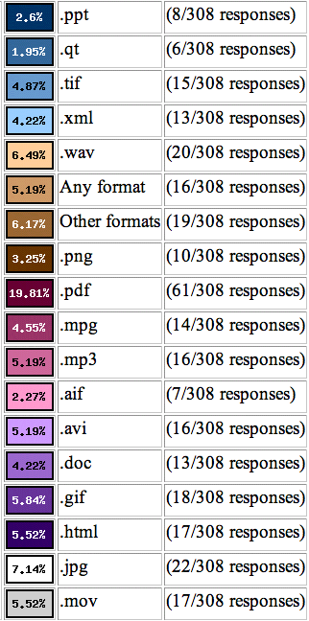
ETD File Formats
85% PDF
30% JPG
27% WAV
24% GIF
23% HTML, MOV
21% AVI, MP3
Notes:
The survey sought to determine the file formats that institutions accept with ETDs because this is an important element of preservation planning and of future format migration considerations. The MetaArchive is format agnostic, ingesting all file formats into its DDPN.
The range of file formats that comprise ETDs at the survey respondents’ universities, matches those the MetaArchive has already ingested and those that were corrupted and rebuilt during extensive network testing.
Such information as file formats along with other metadata is tracked through the MetaArchive Conspectus Database, which contains each institution’s detailed descriptions of the collections in the DDPN. The metadata is used for a variety of purposes such as administration of the network (management, harvesting, maintenance, and recovery), public understanding of the collections, and future activities such as format migration.
We’ll cover the Conspectus Database and metadata about ETD collections in the Dark Archive Preservation Network later.

Slide 9
ETD Collections are hosted by
26% DSpace
13% ETD_db
3% Fedora
1% Eprints
29% Locally developed systems
29% Others
Notes:
As anticipated, ETDs are hosted by a variety of platforms and repositories.
Others mentioned were CONTENTdm, DigitalCommons, DigiTool, and ProQuest.

Slide 10
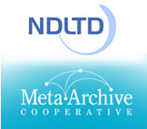
ETD Preservation Survey
73% did NOT have a preservation plan
92% interested in the Networked Digital Library of Theses and Dissertations + MetaArchive Cooperative
preservation strategy
Notes:
We used an online survey to gauge the digital library community’s interest in an ETD-specific archive.
We learned that 80% of the survey respondents accept ETDS at their institutions and 40% of those institutions accept only electronic versions. HOWEVER, only ¼ had preservation plans, which means that a huge percentage (73%) do NOT have formal preservation plans. I found this shocking.
So not only did we have a good idea and a good strategy, we could meet a very broad need among institutions with electronic theses and dissertations.

Slide 11
http://www.ndltd.org
Notes:
Most of you may be familiar with the NDLTD, whose mission includes promoting the preservation of ETDs. To address this goal
The NDLTD created a strategic alliance with

Slide 12
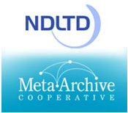
http://www.metaarchive.org
Notes:
with the MetaArchive Cooperative, We share the concern that the digital items that define our culture and history might be forever lost due to disaster, error, or neglect, if we don’t do something and do it together—cooperatively, not individually.

Slide 13
http://www.metaarchive.org
Notes:
The MetaArchive Cooperative began as 6 research universities in the southeastern United States with an award from the Library of Congress. Today we are a membership-funded organization of over 50 institutions in 13 states and 4 countries.
“The MetaArchive Cooperative is one of the few library-led digital preservation organizations that has an infrastructure within as well as between libraries.

Slide 14
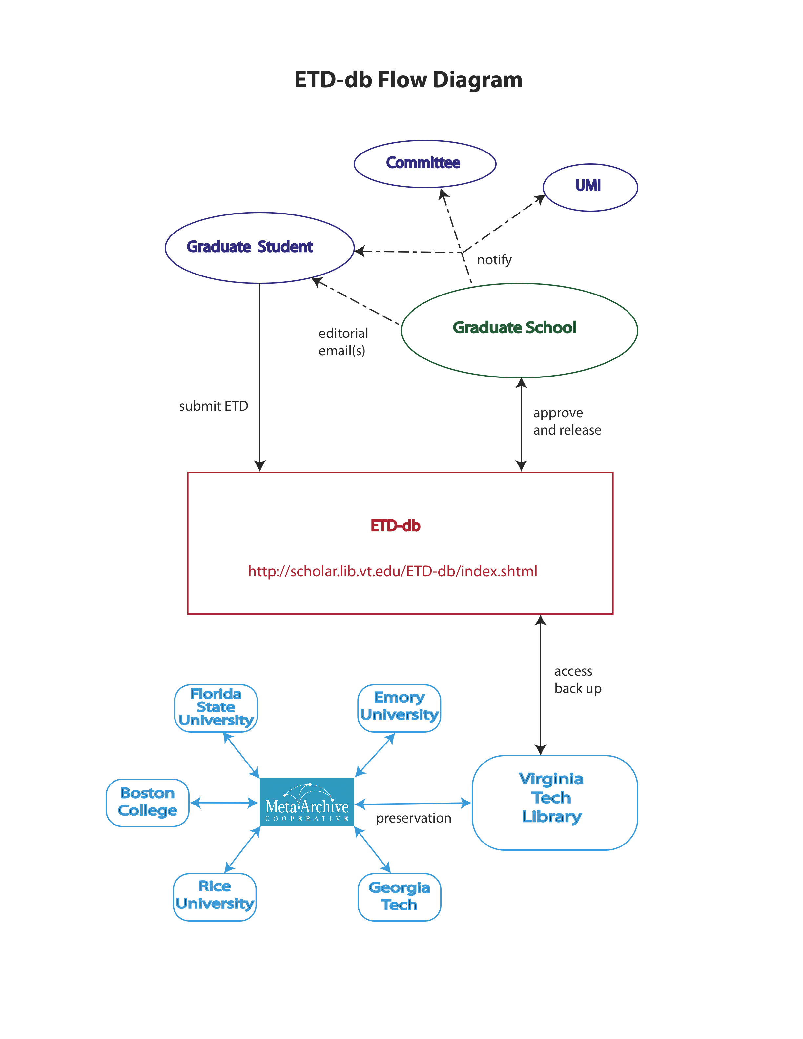
Notes:
Here is a sample workflow for one institution, Virginia Tech. It shows the Student submitting an ETD through Graduate School approval and ingest into the Distributed Digital Preservation Network.

Slide 15
Notes:
This is the follow-thorough for the work flow from the DDPN perspective.
Note (1) that all ETDs, no matter their level of access from their home institutions, can be ingested and preserved by the MetaArchive, and (2) that recovery has been well tested—in both controlled and unplanned settings.
Programmatically harvest ETDs from host universities (LOCKSS)
Secure access: only authorized partners’ servers
Distributes content among partners
International digital preservation network
Standard hardware, free software
Audits and repairs content from partners as needed
Low cost to administer and run
Dark Archive only
http://scholar.lib.vt.edu/theses/NDLTD/NDLTDPreservationPlan2010.pdf

Slide 16
Why participate in the MetaArchive?
The MetaArchive has proven that community-based and community-governed approaches to digital preservation work. The MetaArchive and its community of contributors and innovators have pioneered administrative, legal, and technology strategies that demonstrate sustainable techniques and secure the enduring preservation of irreplaceable cultural resources and memories.
Notes:
Dwayne K. Buttler, Evelyn J. Schneider Endowed Chair for Scholarly Communication, University of Louisville
http://www.metaarchive.org/references

Slide 17
Notes:
At 3:45 TODAY you can hear more about the highlights and early findings of this product funded by the Institute for Museum and Library Services. To promote good practices and to increase the capacity of academic libraries to reliably preserve ETDs, the project participants are developing a toolkit of guidelines, workshop materials, and set of software tools for lifecycle data management and preservation of ETDs.
Project completion scheduled for end of 2013
Nine guidance documents will be produced
Educational Materials and Workshops
Software tools for Lifecycle Management
Training materials will be available in 2013, including workshop syllabi, training handouts and exercises and PowerPoint presentations
http://metaarchive.org/imls/index.php/Main_Page

Slide 18
MetaArchive and ETD Preservation
Recovery:
Plan for it; don’t put off for another day.
Collaboration:
Everybody participates and everybody benefits
Contact: Gail McMillan gailmac@vt.edu
Notes:
Let me leave you with these 3 suggestions:
Prepare your preservation strategy now.
If you separate community access from preservation, you’ll realize the advantages of focusing on the best strategy for each.
In a Cooperative with mutual goals and strategies we can affordably achieve more together than we can separately.
I think the advantages of using LOCKSS as the MetaArchive has to create and manage a dark archive of ETDs is the best and most affordable solution available today, and I hope you will take advantage of it.
Thank you for this opportunity to share my enthusiasm for ETDs and preservation.

