Slide 1
Notes:
1st SCP logo
1st ej: JIAHR, 1990
2nd ej: Catalyst, 1991
3rd, JTE, 1992

Slide 2
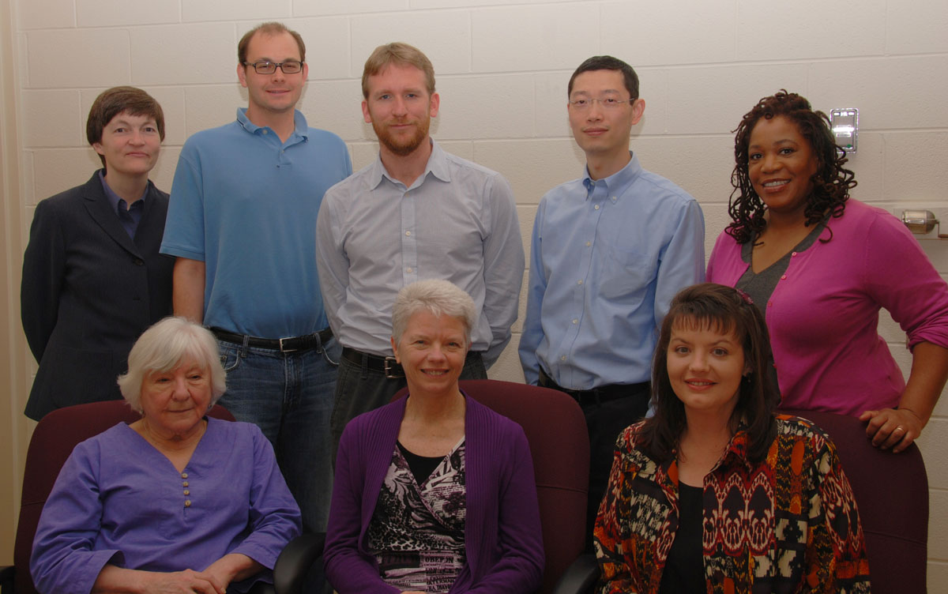
Gail McMillan
Jane Wills
Anne Lawrence
Kimberli Weeks
Zhiwu Xie
Nathan Hall
Keith Gilbertson
Paul Mather
Tracy Gilmore
Intro, History, ETDs, Preservation
VT ImageBase, Metadata
EJournals
Standards & Best Practices
Data Management
VTechWorks
Notes:
Pass the baton:
Jane Wills: VT ImageBase, Metadata
Anne Lawrence: EJournals
Kimberli Weeks: Standards/Best Practices
Zhiwu Xie: Data Management
Nathan Hall: VTechWorks

Slide 3
A Little History: From the Scholarly Communications Project to the Digital Library and Archives
Thanks to Internet Archive’s Wayback Machine
http://archive.org/web/web.php

Slide 4
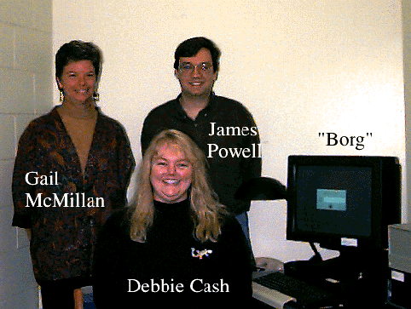
Notes:
Oct. 1996 first server named borg
James Powell created our logo—SCP was the missing piece of the puzzle of your brain. Used until 2000
Yes, it’s hard to read but And that tiled background! Tables! Pictures!

Slide 5
Before the Web there was the Gopher
Notes:
Gphoner was an Internet interface or protocol
Began 1991
Community Services Catalyst full text
Journal of Fluids Engineering raw data only
Journal of the International Academy of Hospitality Research ASCII; PostScript with no. 6
Journal of Technology Education text + graphics
Journal of Analytical and Experimental Modal Analysis article abstracts
Veronica – the search engine system for the Gopher protocol, an acronym for "Very Easy Rodent-Oriented Net-wide Index to Computer Archives"

Slide 6
Notes:
Fall 1997

Slide 7
Notes:
1998

Slide 8
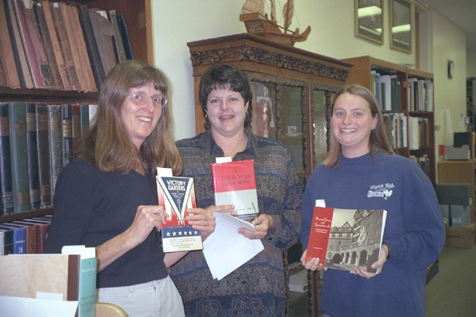
Notes:
1996
1995-2007

Slide 9
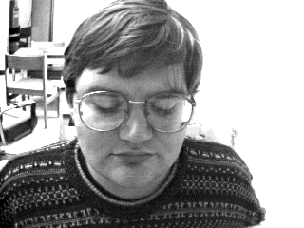
Notes:
1999 we mastered background images. DLA logo designed by Tony Akin, used 2000-2004.
Later that year we got a new server and she’s been named Scholar.lib.vt.edu ever since.
Started using DLA as the formal umbrella including Spec.
2000
Tony Atkins designed this logo and we formally added the special collections staff to the homepage.
We also added the clickable boxes at the bottom, though we hadn’t yet created Cascading Style Sheets so these were manually linked on each page;>(
And, I still liked that background image;>)
We had moved into Torgersen, where systems is today: where’s the image from “Crossing the Lines?”

Slide 11
Notes:
News 2000
Roanoke Times 1992-
Virginian Pilot 1994-
WDBJ7 (CBS affiliate) 1995-2008
International News 1997-

Slide 12
Notes:
2001 IAWA Bio DB

Slide 13
Notes:
2004 ASPIRES grant
The same look and functionality today

Slide 14
Notes:
In 2001 we added a search function and linked to Ask a Librarian. You can see that Spec was expanding and Tony was leaving.
In 2002 I tried to reduce the clutter and pared down the wordy text (I do that periodically after I’ve grown too wordy)

Slide 15
Notes:
2006 First year we had a template for most of our web pages
Carolyn Kletnieks, designed logo , used 2005-2010

Slide 16
Notes:
Spec 2007 – DLA’s last

Slide 17
Notes:
2009 ETDs

Slide 19
 | All VT ETDs
Open Access | 10,510
VT-only | 8,541
Mixed | 93
Withheld | 700
 | 19,844

Slide 22
Notes:
2001 and 2012 VT ImageBase

Slide 23
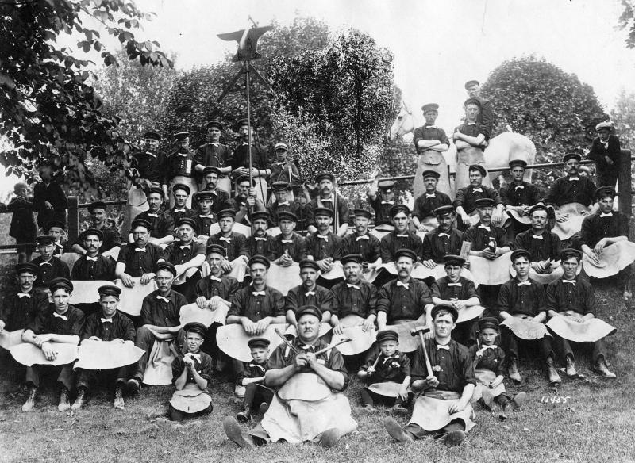
Notes:
ns4968
Title Railroad farriers
notes The "men in funny skirts" are farriers; they shoe horses. The technique they use is blacksmithing, but farriers are specific usually. There is a horse in the upper right of the picture (the back end of one). The farrier would put the horses hoof in the lap of the skirt. It would keep him from getting kicked in the privates! From William Rogers 9/17/02
source Norfolk & Western Historical Photograph Collection

